Slide 1
TCP/IP Model
Lecture No-(5-6)
Computer Networks _22CS008
Prepared by
Dr. Neha Sharma (CSE)
Department of Computer Science and Engineering
Chitkara University, Punjab

Slide 2
Index
TCP/IP Protocol suite
TCP/IP Protocol Model
Comparison of OSI and TCP/IP
Internet Standards
Electronics and Communication Standards

Slide 3
TCP/IP Protocol Suite
The layers in the TCP/IP protocol suite do not exactly match those in the OSI model.
The original TCP/IP protocol suite was defined as having four layers: host-to-network, internet, transport, and application.
However, when TCP/IP is compared to OSI, we can say that the TCP/IP protocol suite is made of five layers: physical, data link, network, transport, and application.

Slide 4
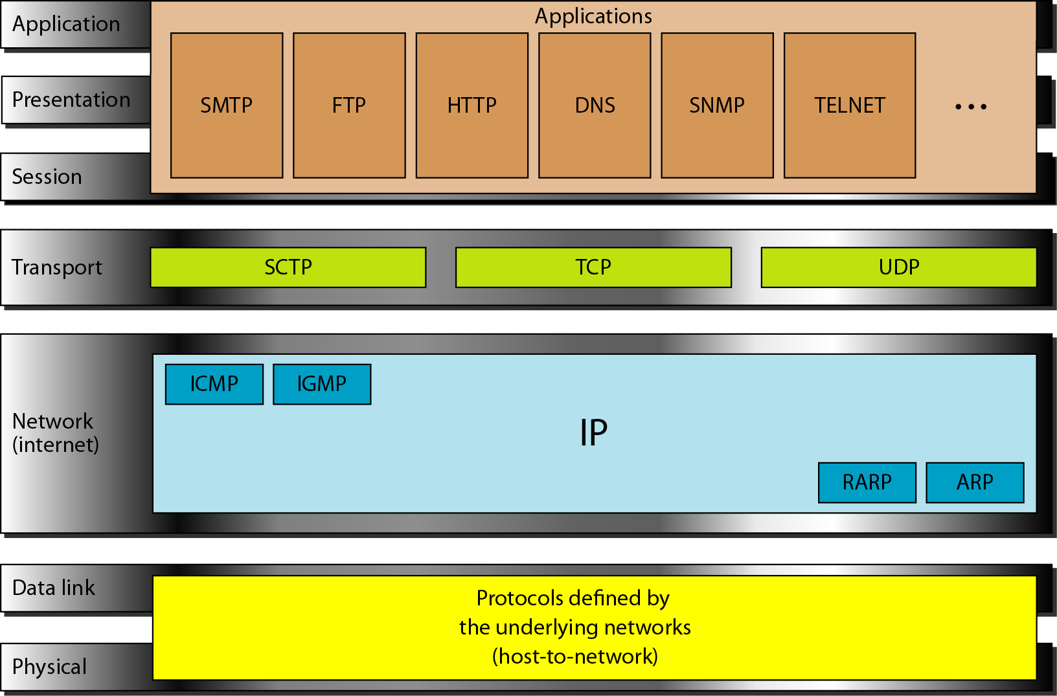
TCP/IP model
Figure1 TCP/IP model with protocol of each layer

Slide 5
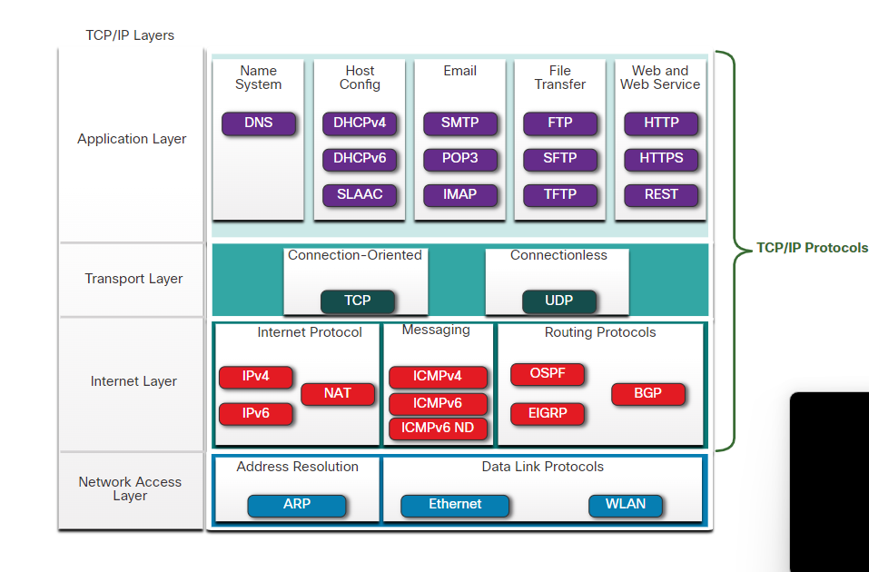
TCP/IP Protocol suite
Today, the TCP/IP protocol suite includes many protocols and continues to evolve to support new services. Some of the more popular ones are shown in the figure. TCP/IP is a protocol suite used by the internet and the networks of today. TCP/IP has two important aspects for vendors and manufacturers
Open standard protocol suite- Freely available to the public.
Standard-based protocols suite: It is endorsed by the networking industry and approved by standard organizations. This ensures products from different manufacturers can interoperate successfully.
TCP/IP Protocol
Figure 2 Shows TCP/IP protocol Suite with some popular protocol

Slide 6
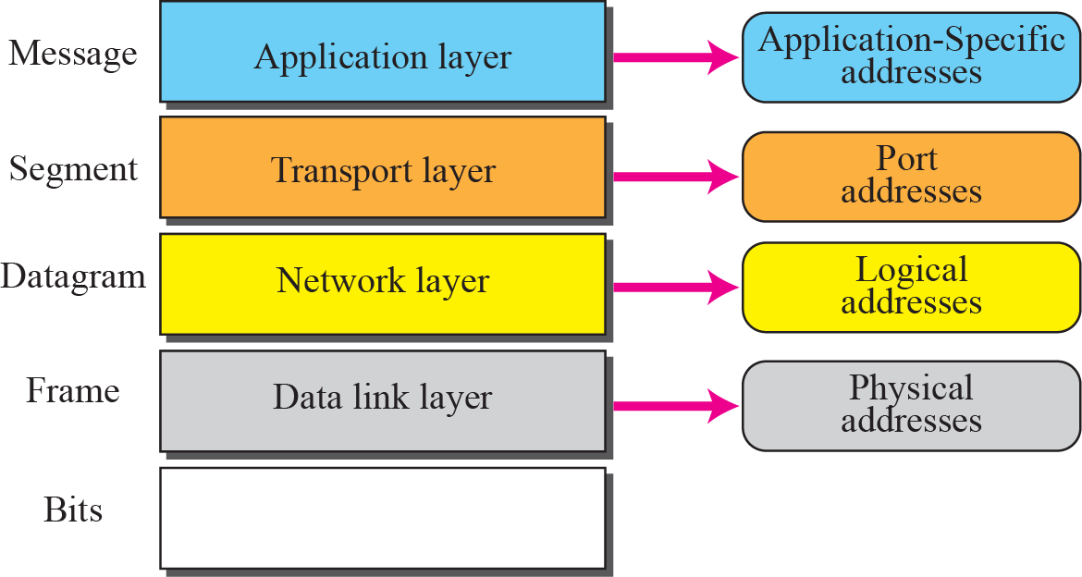
TCP/IP Model
Addresses in the TCP/IP protocol suite
Figure 3 TCP/IP model addresses overview

Slide 7
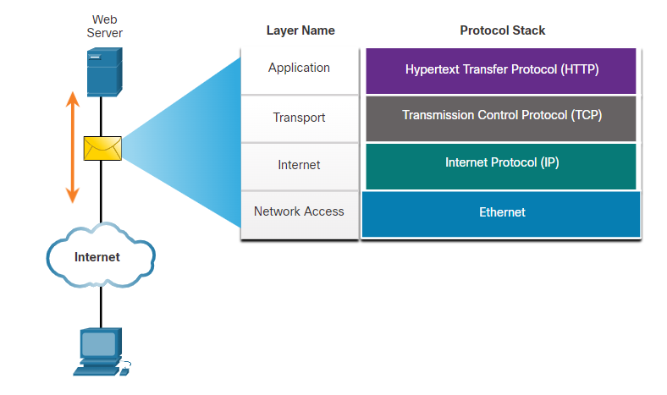
TCP/IP Protocol Example
The figure 4 shows an example of the three TCP/IP protocols used to send packets between the web browser of a host and the web server. HTTP, TCP, and IP are the TCP/IP protocols used. At the network access layer, Ethernet is used in the example. However, this could also be a wireless standard such as WLAN or cellular service.
Figure 4 TCP/IP protocol example.

Slide 8
Comparison of OSI and TCP/IP Model
One of the major difference is that OSI is a conceptual model which is not practically used for communication, whereas, TCP/IP is used for establishing a connection and communicating through the network.
The OSI model mainly emphasis on the services, interfaces and protocols; make a clear distinction between these concepts. Conversely, the TCP model is not able to distinctly describe these concepts.
Furthermore, the TCP/IP enables only connectionless communication mode in the network layer but both modes (Connectionless and connection-oriented) in the transport layer. When it comes to the OSI model, it supports connectionless and connection-oriented communication over the network layer but in the transport layer, connection-oriented communication is merely allowed.

Slide 9
Comparison of OSI and TCP/IP Model
OSI (Open System Interconnection) model was introduced by ISO (International Standard Organization). Currently OSI (Open System Interconnection) model is just a reference model. Means that, there are no real working implementations of OSI Model on any of latest network infrastructure devices or Operating Systems. OSI (Open System Interconnection) model is used these days only as a reference model for teaching computer networking concepts and for understanding how computer networks operate.
The roots of TCP/IP (Transmission Control Protocol Internet Protocol) are with US Department of Defense (DoD). Original TCP/IP (Transmission Control Protocol/Internet Protocol) model had only four layers, and later an updated model evolved with five layers. TCP/IP protocol suite and thus TCP/IP model got wider acceptance than OSI model, because world’s largest network internet started operating using TCP/IP protocol suite.

Slide 10
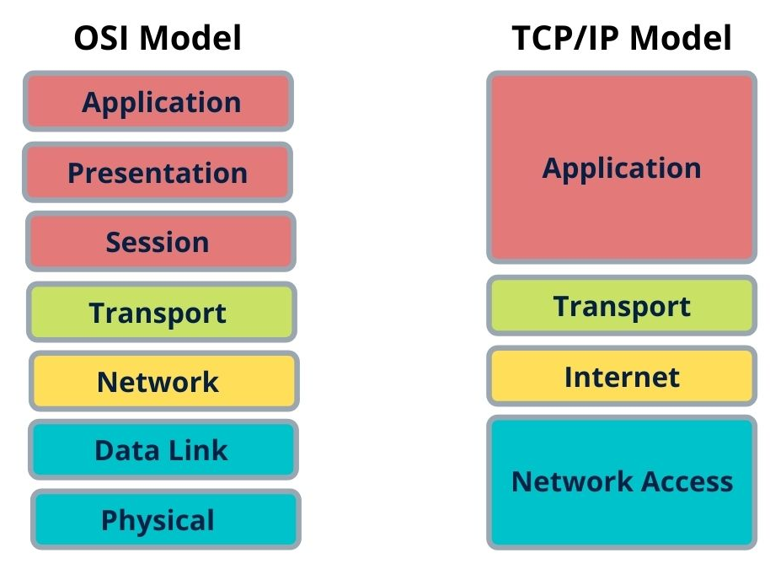
Comparison of OSI and TCP/IP Model
Figure 5 Comparison of OSI and TCP/IP model

Slide 11
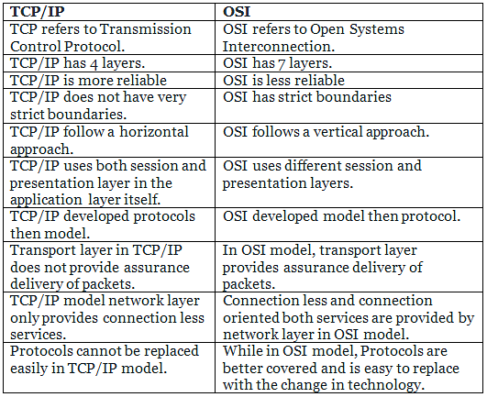
Comparison of OSI and TCP/IP Model
TCP/IP model is developed by Department of Defence, whereas OSI model was developed by ISO.
Four layers in TCP/IP whereas seven layers in OSI model.

Slide 12
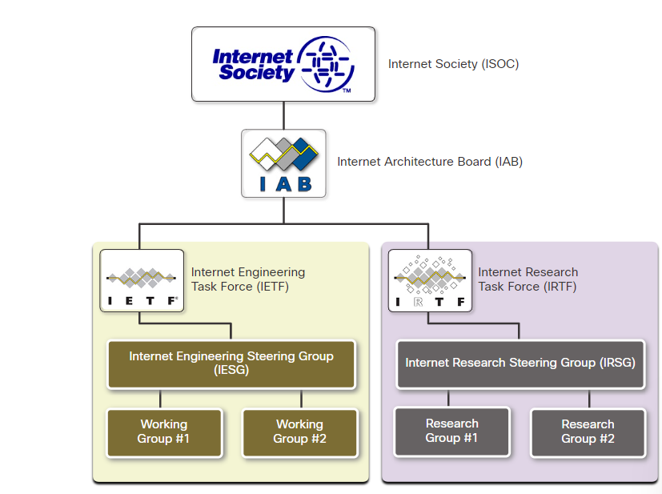
Internet Standards
Various organizations have different responsibilities for promoting and creating standards for the internet and TCP/IP protocol. The figure 6 displays standards of organizations involved with the development and support of the Internet.
Internet Society (ISOC)
Internet Architecture Board(IAB)
Internet Engineering Task Force (IETF)
Internet Research Task Force (IRTF)
Figure 6 Displays standards of organizations

Slide 13
Electronics and Communications Standards
These standard organizations include the following:
Institute of Electrical and Electronics Engineers (IEEE, pronounced “I-triple-E”) - Organization of electrical engineering and electronics dedicated to advancing technological innovation and creating standards in a wide area of industries including power and energy, healthcare, telecommunications, and networking.
Electronic Industries Alliance (EIA) - Organization is best known for its standards relating to electrical wiring, connectors, and the 19-inch racks used to mount networking equipment.
Telecommunications Industry Association (TIA) - Organization responsible for developing communication standards in a variety of areas including radio equipment, cellular towers, Voice over IP (VoIP) devices, satellite communications, and more.
International Telecommunications Union-Telecommunication Standardization Sector (ITU-T) - One of the largest and oldest communication standards organizations. The ITU-T defines standards for video compression, Internet Protocol Television (IPTV), and broadband communications, such as a digital subscriber line (DSL).

Slide 14
Questions
Which three acronyms/initialisms represent standards organizations? (Choose three.)
IANA
IETF
TCP/IP
OSI
MAC
IEEE
What type of communication will send a message to all devices on a local area network?
multicast
unicast
broadcast
Allcast
In computer communication, what is the purpose of message encoding?
to convert information to the appropriate form for transmission
to negotiate correct timing for successful communication
to break large messages into smaller frames
to interpret information
Which message delivery option is used when all devices need to receive the same message simultaneously?
multicast
unicast
broadcast
duplex

Slide 15
Questions
What are two benefits of using a layered network model? (Choose two.)
It prevents designers from creating their own model.
It prevents technology in one layer from affecting other layers.
It ensures a device at one layer can function at the next higher layer.
It assists in protocol design.
It speeds up packet delivery.
What is the purpose of protocols in data communications?
specifying the device operating systems that will support the communication
dictating the content of the message sent during communication
specifying the bandwidth of the channel or medium for each type of communication
providing the rules required for a specific type of communication to occur
Which logical address is used for delivery of data to a remote network?
destination MAC address
destination IP address
source IP address
source MAC address
destination port number
References :
Data Communications and Networking’ by Forouzan, 5th Edition, 2013
Netacad course

